Slide 1

Health Status Predictors of Cost and Deaths
AArete Group 2

Slide 2





Our Team
Charlie Doubet
Eddie Martin
Nathan Bers
Robert Mullan
Seth Barker

Slide 3
Agenda
Background
Industry Context
Objective
Goals
Approach
Data Collection
Master Dataset
Analytical Approach
Exploratory Data Analysis
Graphs
Initial Findings
Results
What we Found
Recommendations
Implementations
Next Steps
Data Limitations
What We Would do Different

Slide 4
Background

Slide 5

Industry Context
The U.S. healthcare system is evolving rapidly:
AI, telehealth, remote monitoring are transforming care delivery
Increasing costs and investment in treatments and technology
Understanding key health indicators that are driving costs and mortality is essential for shaping effective policy and spending decisions
Notes:
Put a source as a footnote. No url needed. The U.S. healthcare system is evolving rapidly. AI, telehealth, and remote monitoring are all transforming care delivery. But costs continue to rise, and it's not always clear whether that money is being spent effectively. Identifying the key drivers of both cost and mortality can help shape smarter policies.

Slide 6
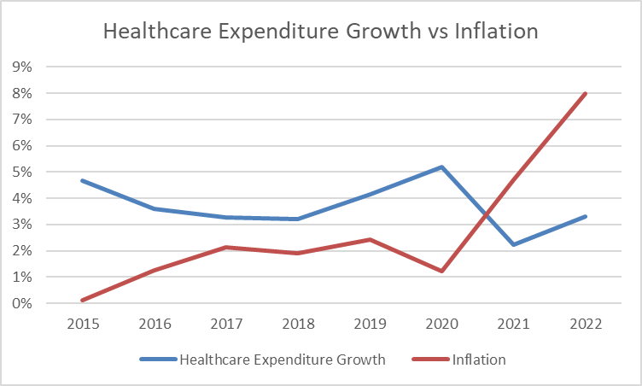
Trends in Healthcare Spending
Healthcare spending increased each year
Growth outpaced inflation 26% to 22%
Notes:
Put a source as a footnote no url needed. Healthcare Spending continues to increase, but outcomes don’t always improve with it. This inconsistency is why it is important to explore whether lifestyle factors, play a bigger role in spending.

Slide 7
Objective
Healthcare Spending
Is there a connection between a states ranking in a specific health indicator and its healthcare spending per person?
Health Outcomes
Which health indicators are the strongest predictors of deaths per 100,000 individuals?
Notes:
Our objective is to determine which health and lifestyle factors drive high spending and high death rates. We especially focused on the Southeastern U.S., where health outcomes tend to lag behind

Slide 8
What is the Goal?
Smarter Resource allocation
Better Public health Policies
Improved Patient Outcomes
Notes:
The goal of this analysis is to understand how to distribute healthcare spending more effectively. By identifying the drivers of poor health outcomes, we can inform policies that target root causes of poor health. Everything we analyzed points toward one goal which is helping people live healthier, longer lives. That means fewer preventable deaths and a higher quality of life across all regions, especially in underserved areas.

Slide 9
Hypothesis
There is no significant correlation between a state's healthcare spending and its death rate per 100,000. However, southeastern states tend to have poorer health outcomes compared to the rest of the US, suggesting a need for targeted interventions in this region.

Slide 10
Approach
Notes:
To test our hypothesis, we followed a four-part approach: collecting data, creating a master dataset, running analysis using tools like Tableau and Excel, and then validating our findings with AI-assisted insights and decision trees in Orange.

Slide 11




Data Collection
KFF Health Data
CDC (NCHS)
Healthdata.gov
Data.gov
County Health Rankings
Notes:
We gathered data from highly reliable organizations including KFF, CDC, HealthData.gov, and the County Health Rankings. These gave us reliable data in variables on health, demographics, and spending.

Slide 12
Creation of Master Dataset
Collected data from multiple public health sources and combined them using AI and python to create unified dataset
Cleaned missing values, standardized column names, and ensured consistency across all metrics
Included the timeframe from 2014-2022 for all data
Notes:
Next, we cleaned and joined the datasets. Our master dataset included over 30 columns across health behaviors, outcomes, and demographic indicators. This allowed for a multi-dimensional analysis.

Slide 13
Health Categories Present in Master Dataset
Health Outcomes & Conditions
Healthcare Access & Coverage
Mental & Physical Distress
Food & Nutrition
Mortality Rates
Cause-Specific Death Counts
Demographics
Economic Indicators
Notes:
Just to give a little insight into our dataset, this shows the different categories. Many things play into health besides just standard health indicators

Slide 14



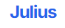
Analytical Approach
Exploratory Data Analysis (Tableau)
Correlation matrix (Excel)
Decision tree model (Orange for data mining)
AI-supported insights (Julius and Chat)
Notes:
We used Tableau for visualizing trends, Excel for correlation matrices, Orange for decision tree modeling, and tools like ChatGPT and Julius for exploratory insights. This blend of traditional and AI-driven analysis gave us deeper confidence in our conclusions.

Slide 15
Exploratory Data Analysis

Slide 16
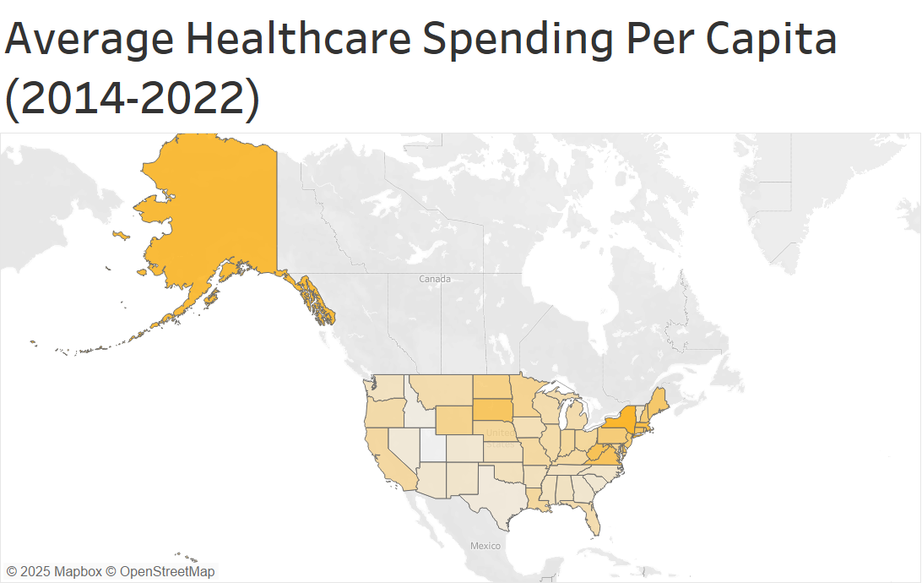
KFF, Healthcare Spending 2014-2022
Notes:
To begin we started by examining the average healthcare spending per capita across the U.S. from 2014 to 2022. On the left, we’ve broken down the top and bottom 10 states by average spending. States like New York, Alaska, and Massachusetts spend significantly more on average, above $12,000 per person. On the other hand, states like Utah, Idaho, and North Carolina spend much less, around $7,000 to $8,000. On the map to the right, the darker shade the states that spend more and gives us a clearer view to where in the US is spedning more.

Slide 17
Comparing Health and Spending: Best Performing States
Notes:
Flip left chart so Alaska is on the left. Next, we wanted to see if higher spending actually led to better outcomes. On the left, shows the top 10 states with the lowest death rates per 100,000 people. Illinois, Massachusetts, and Idaho all rank high in health outcomes. On the right, we show the top 10 states in terms of spending per capita. While there’s some overlap, like Massachusetts, many of the states with low mortality rates aren’t necessarily the biggest spenders. This raised the question: Is money really the biggest factor in health?

Slide 18
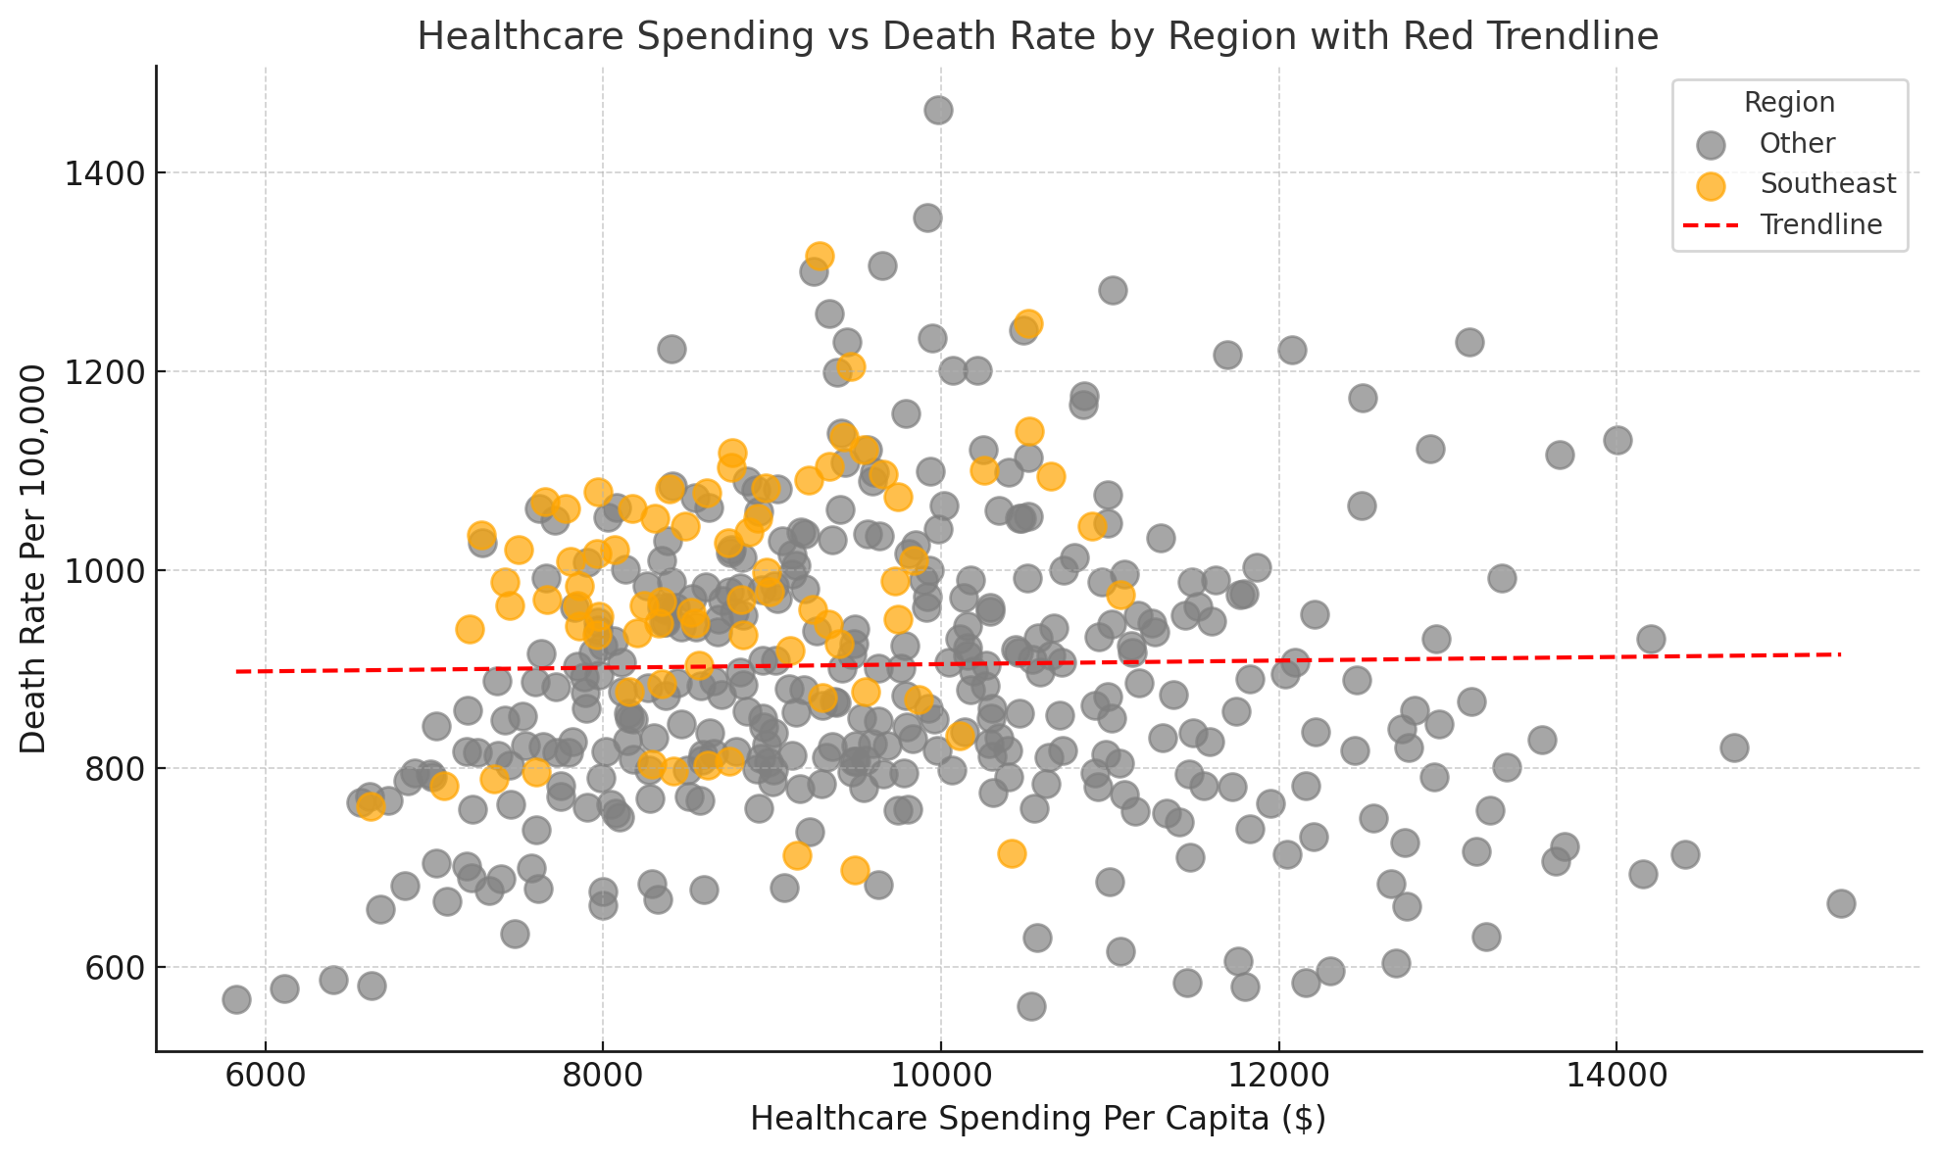
Healthcare Spending Does Not Strongly Predict Better Health Outcomes
Very weak correlation between healthcare spending per capita and death rates
Other factors (like obesity, smoking, and income) likely have stronger impacts on death rates
Notes:
To answer that, we ran a correlation analysis. The scatterplot here shows healthcare spending per capita on the x-axis and death rate on the y-axis. As you can see from the red trendline, the correlation is very weak. This suggests that more spending does not necessarily mean lower death rates. Instead, we started thinking about what other variables might matter more.

Slide 19
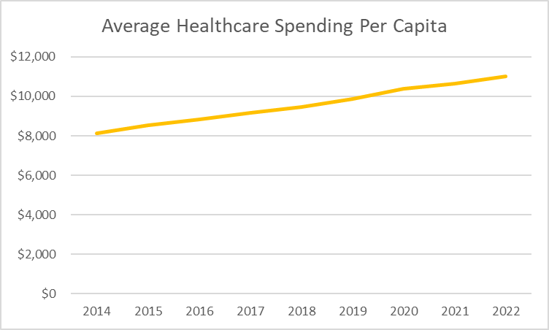
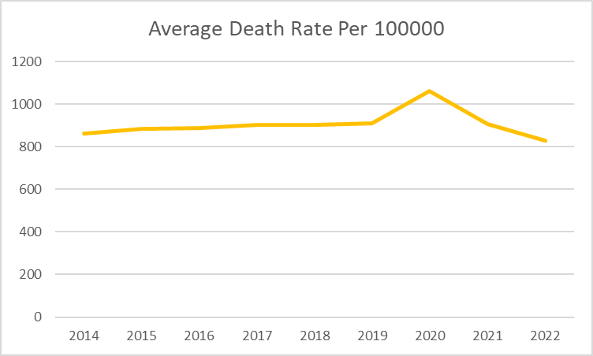
Average Healthcare Spending and Death Rates Over Time
Notes:
We wanted to look at the trends overtime for spending and mortality rates. On the left, we can see that healthcare spending steadily increased from 2014 to 2022. But on the right, the death rate per 100,000 doesn't really follow that same upward pattern. However, it peaked in 2020, likely due to COVID and then drops off. This suggests that more spending doesn't necessarily result in improvements in mortality. Aal factors.

Slide 20
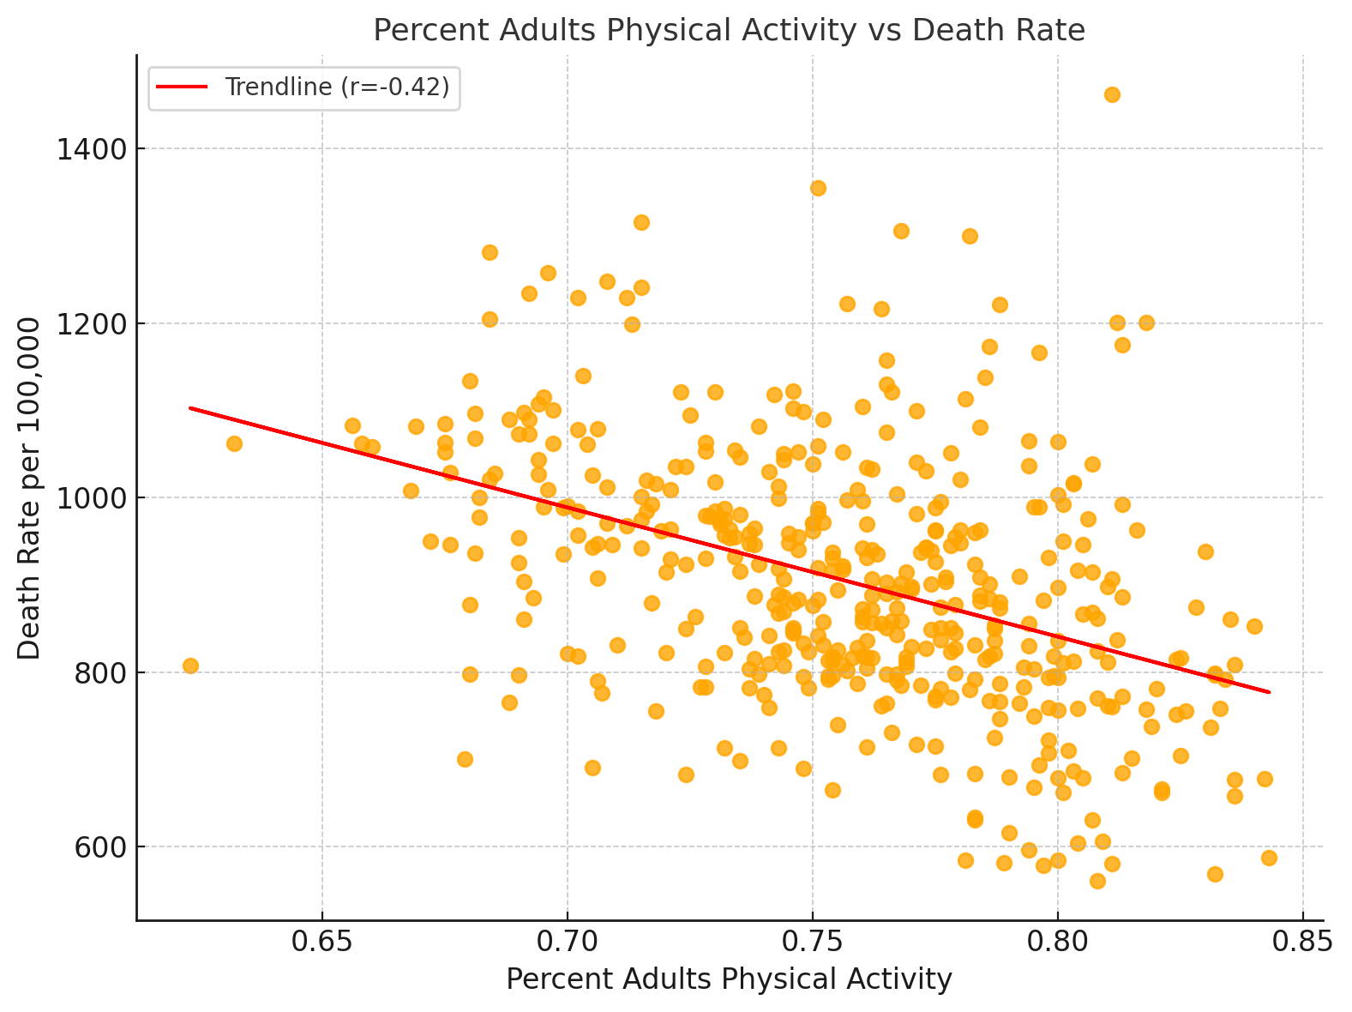
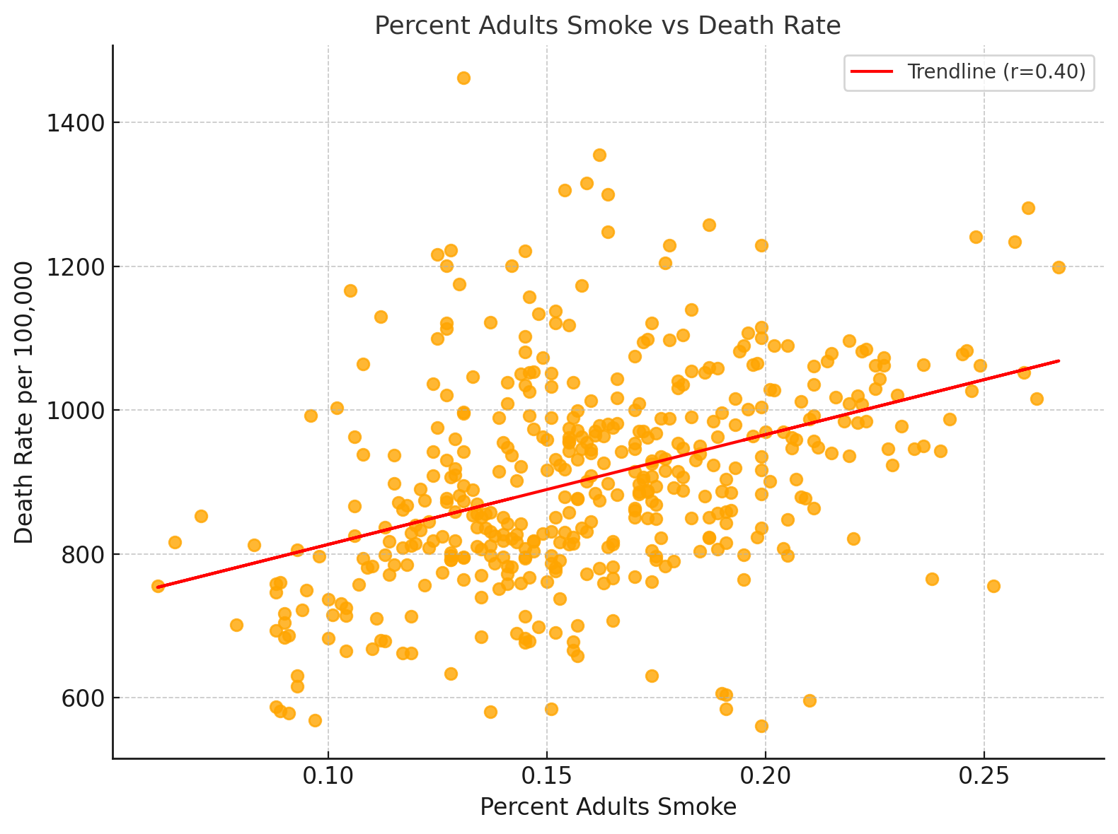
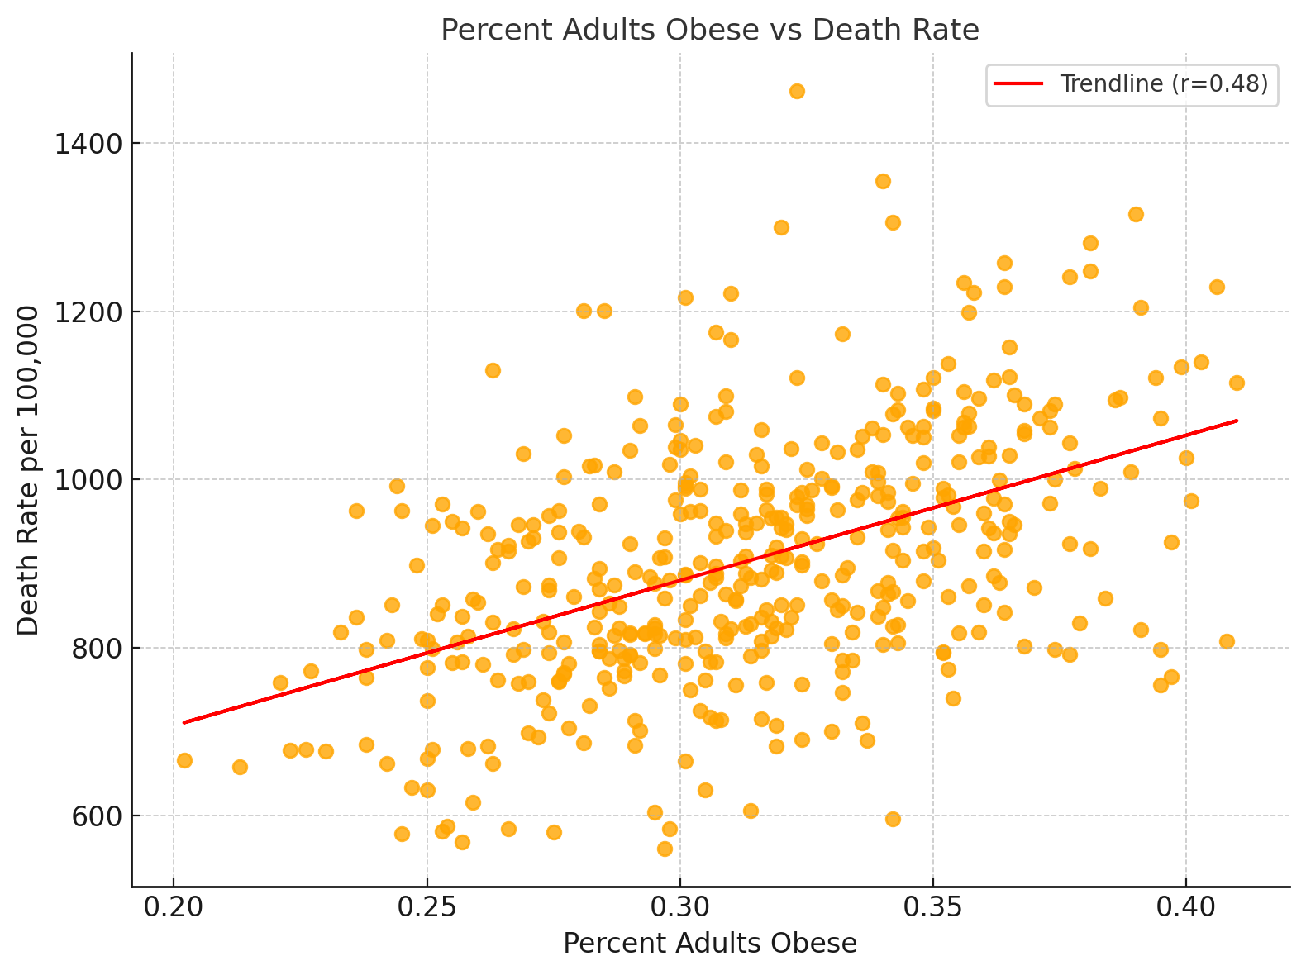
Lifestyle Factors Are Strong Predictors of Mortality Rates
KFF, Lifestyle Factors Effecting Health
Notes:
Note: Add coloring to the graph. We then looked at lifestyle factors that had the highest correlation with mortality like physical activity, smoking, and obesity. For example, higher physical activity clearly correlates with lower death rates on the left, while higher smoking and obesity rates are tied to worse outcomes.

Slide 21
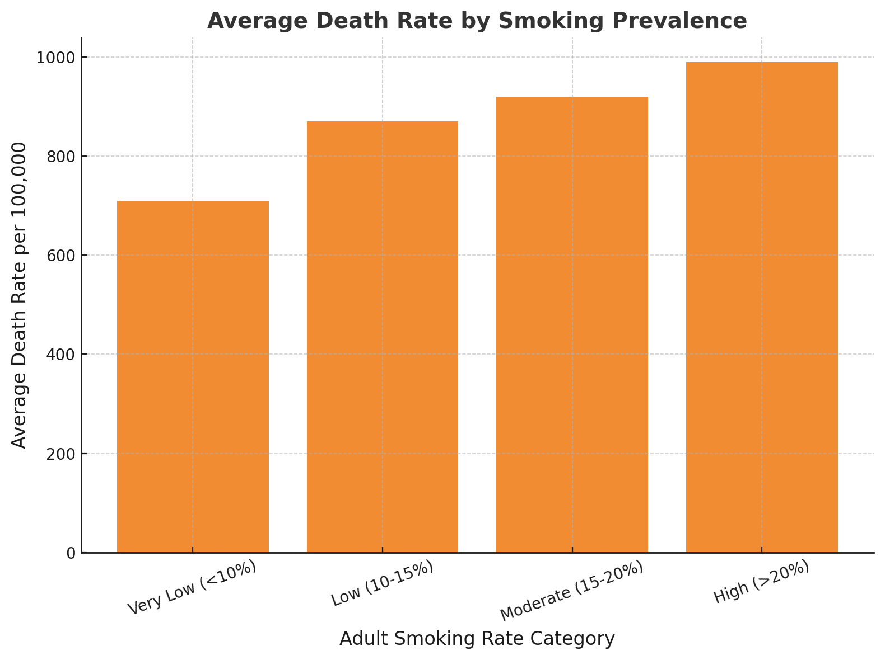
Higher Smoking Rates Lead to Higher Mortality
Higher smoking rates drive higher death rates and chronic disease deaths
Death rates rise by about 42% between low-smoking and high-smoking states
KFF, Smoking Rates and Outcomes
Notes:
Note: "Death rates rise by x%" instead of 300. This chart breaks down average death rates by smoking categories. States with very low smoking rates have an average death rate around 700 per 100,000, while states with high smoking rates exceed 1,000. That’s a 300-death difference, which underscores just how impactful smoking can be on public health outcomes.

Slide 22
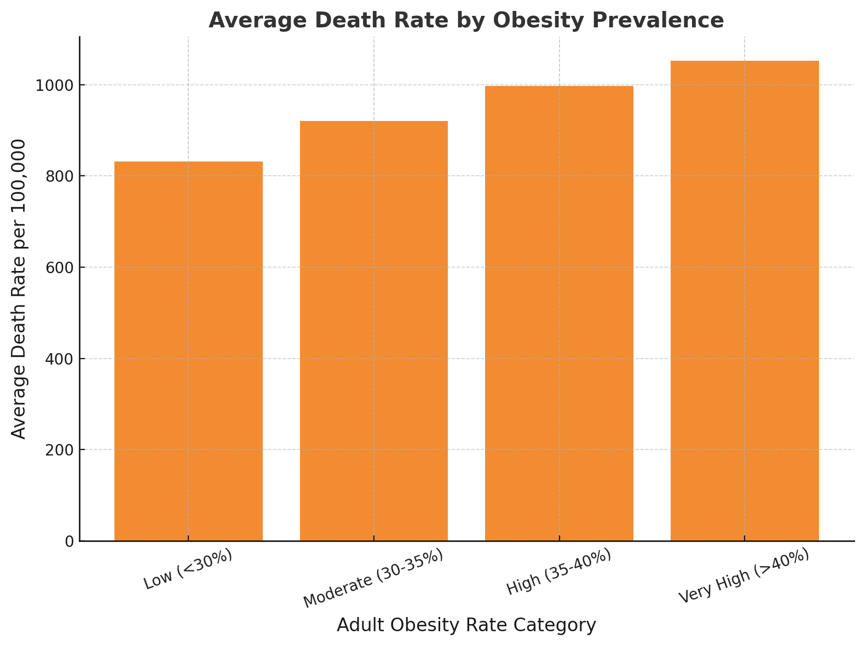
Higher Obesity Rates Lead to Higher Mortality
Higher obesity rates show higher death rates across the U.S.
Obesity is strongly linked to chronic diseases like diabetes, heart disease, and cancer
KFF, Health Indicators Effecting Mortality
Notes:
Obesity shows a very similar pattern. As obesity prevalence increases, so does the average death rate. This is likely because obesity is linked to many chronic diseases like diabetes, heart disease, and cancer. It’s another clear signal that lifestyle factors are driving health outcomes.

Slide 23
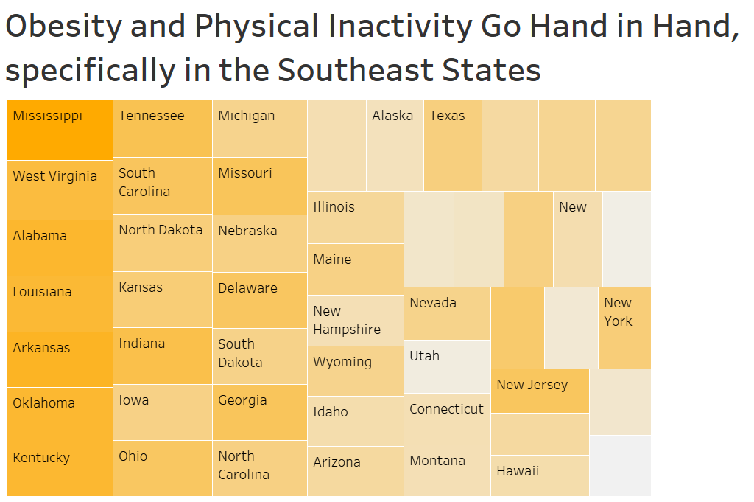
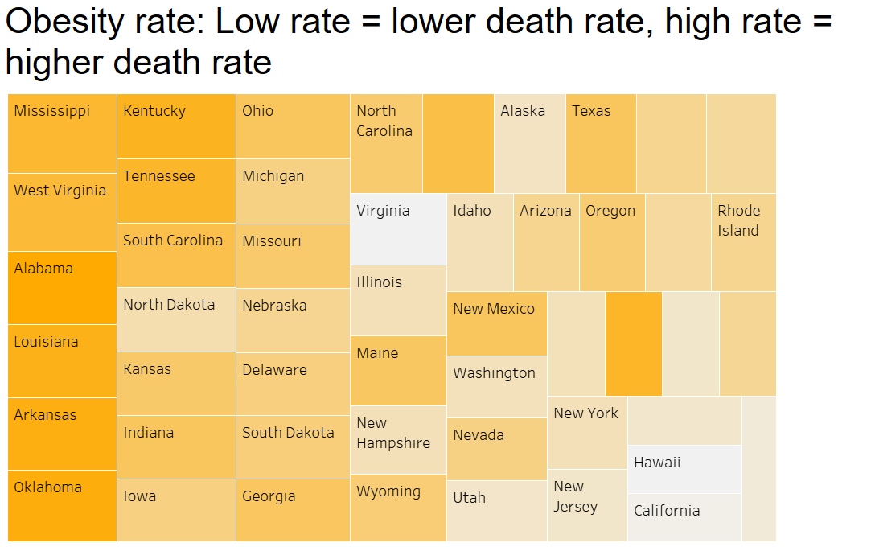
Notes:
Note: Add a title here. We then looked geographically at how obesity and inactivity overlap. On the left, states with darker orange—like Mississippi, West Virginia, and Alabama—show high obesity and low physical activity. On the right, you’ll see those same states are also the ones with the highest death rates. This visualization made it clear to us that these lifestyle factors go hand-in-hand, especially in the Southeast.

Slide 24
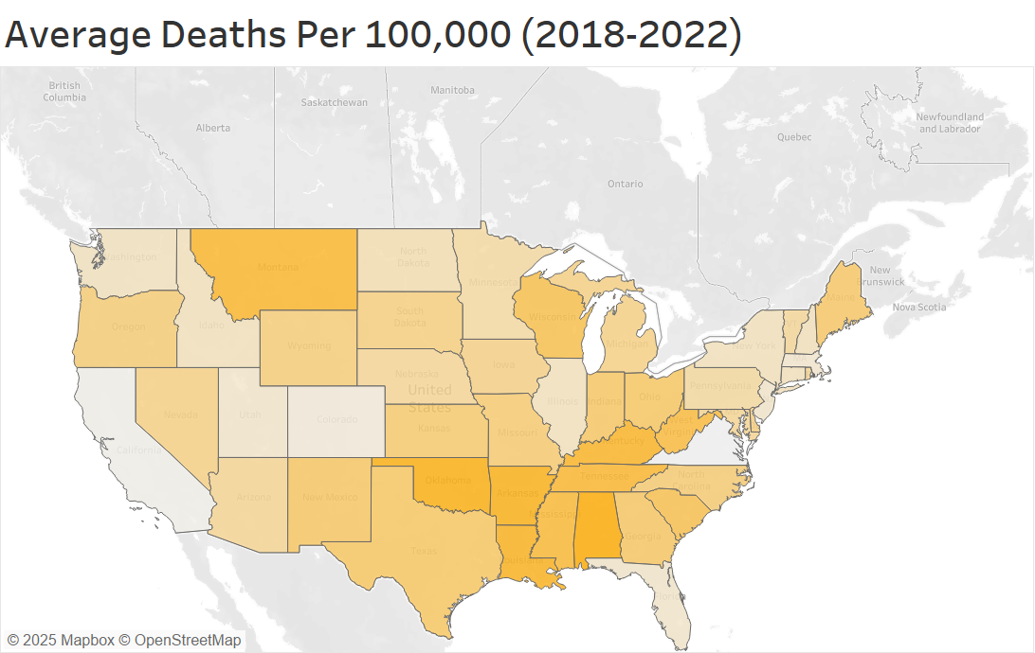
The Southeast Takes up most deaths per 100,000 within the US
Notes:
Here we zoom in on the actual death rate. This heatmap shows average deaths per 100,000 from 2018 to 2022. The Southeast stands out clearly. These are the states driving up the national average and consistently underperforming on health indicators like smoking and obesity from previously.

Slide 25
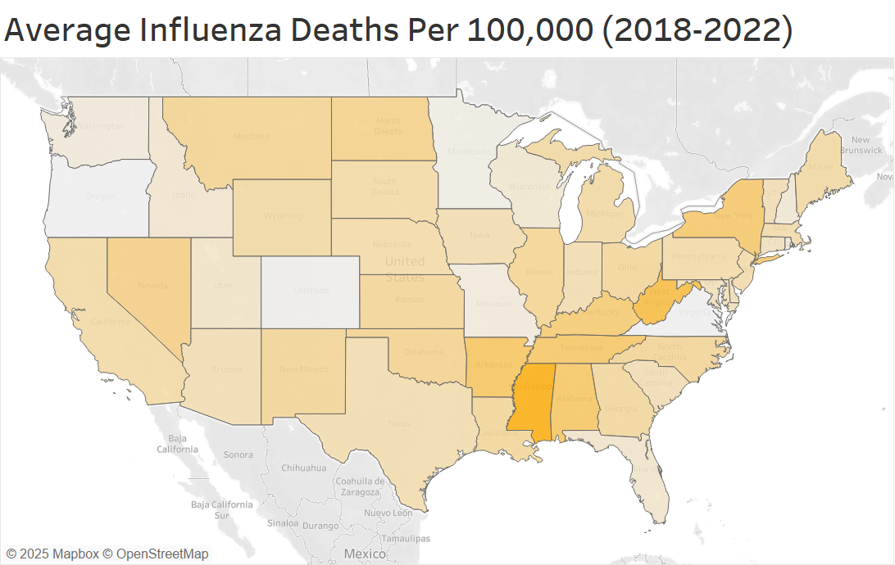
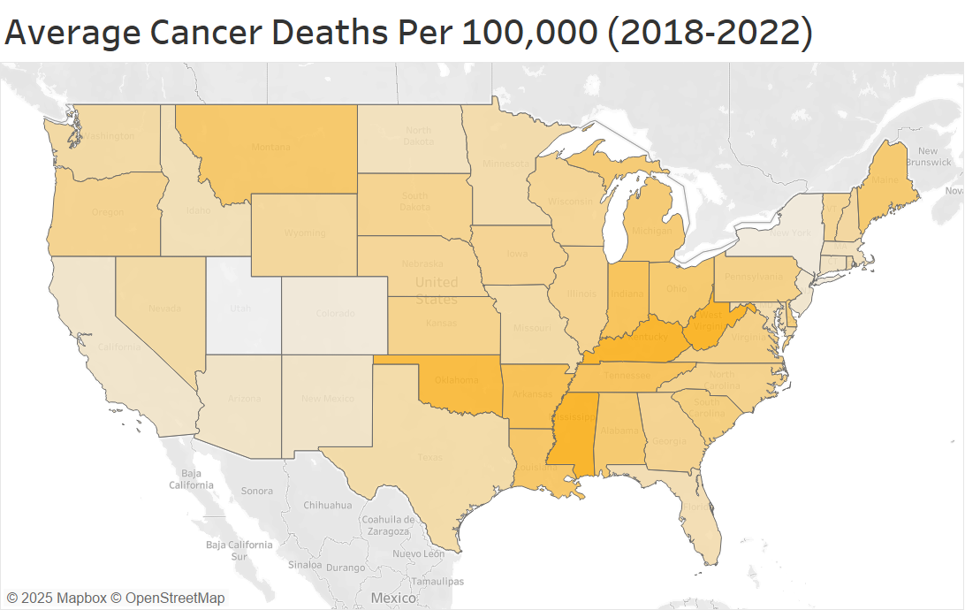
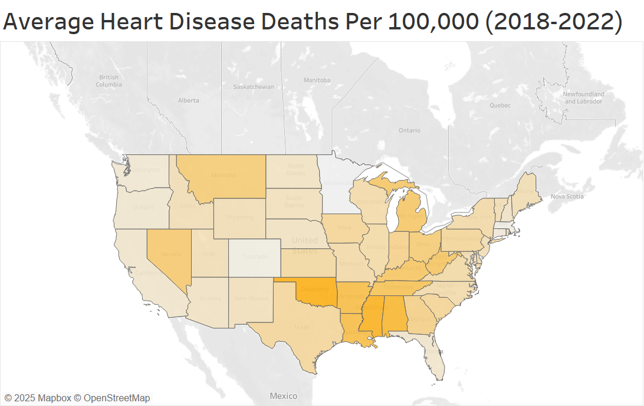
The Southeast continues to rank highest in Deaths for specific outcomes
Notes:
Note: Mention a deviation from the norm to make for an interesting insight. A state that we didn't expect maybe. To take it a step further, we analyzed specific causes of death: On the left is influenza-related mortality, In the center is heart disease, And on the right is cancer. In all three maps, the Southeast again leads in death rates. These are conditions that, to a large extent, are manageable and suggest us to focuse on public health initiatives rather than just increasing spending

Slide 26
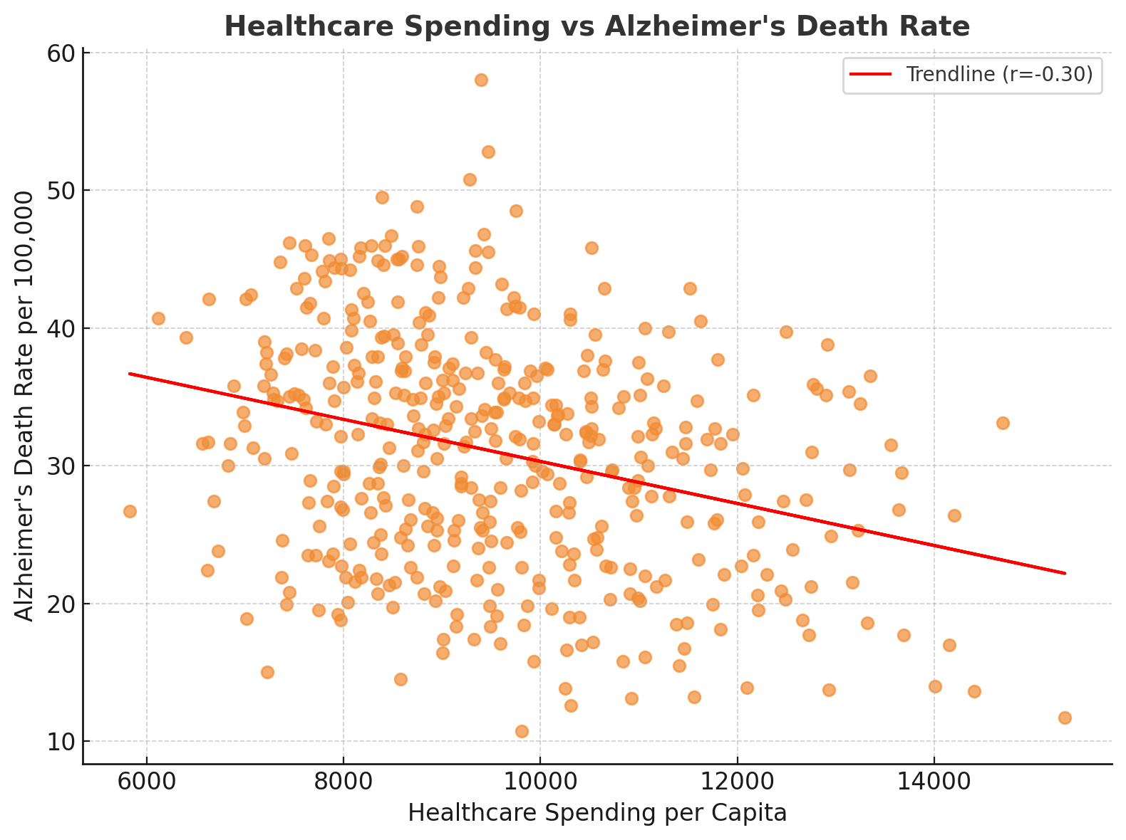
Higher Health Spending Leads to Less Alzheimer's Deaths
This may be due to earlier diagnosis, better care, and more access to long-term support from higher healthcare spending
Notes:
Note: This could be due ot patients being treated earlier, make assumptions. Lastly, we found one condition where spending seems to have a more direct impact—Alzheimer’s disease. This scatterplot shows that states with higher healthcare spending tend to have lower Alzheimer’s death rates. That might be due to earlier diagnosis, better care, or more access to long-term support. It’s a reminder that while spending doesn’t fix everything, it can make a difference in the right areas

Slide 27
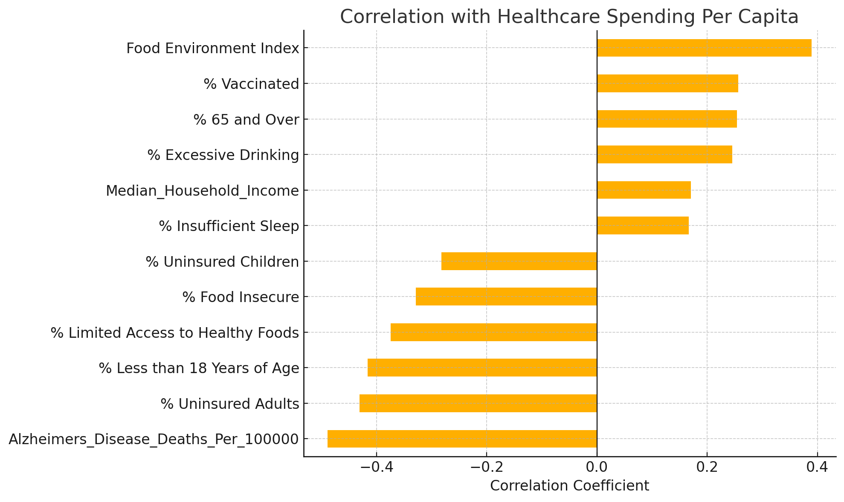
States with better food environments, higher vaccination rates, and older populations tend to spend more on healthcare.
Conversely, higher uninsured rates, child populations, and food access limitations are negatively associated with spending.
Notes:
This chart explores what factors are most correlated with healthcare spending. On the positive side, states with better food environments, higher vaccination rates, and older populations tend to spend more per person. On the other side, higher uninsured rates, younger populations, and limited access to healthy foods are associated with lower spending. This gives us insight into both equity and investment across states—especially how socioeconomic and demographic differences shape spending patterns.

Slide 28
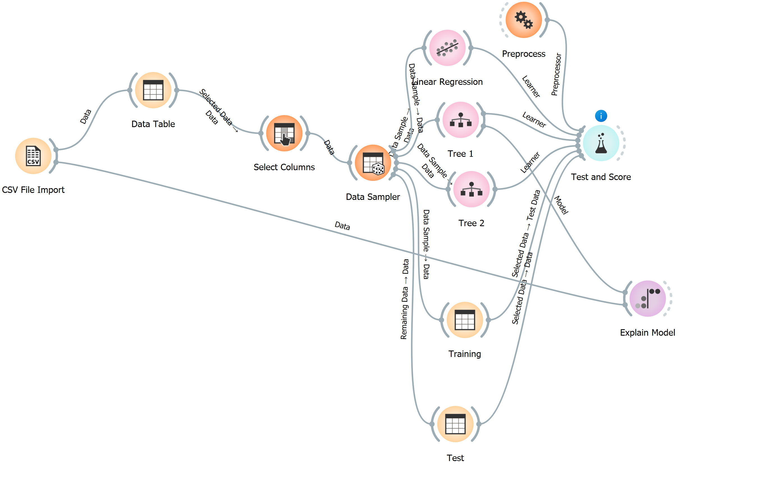
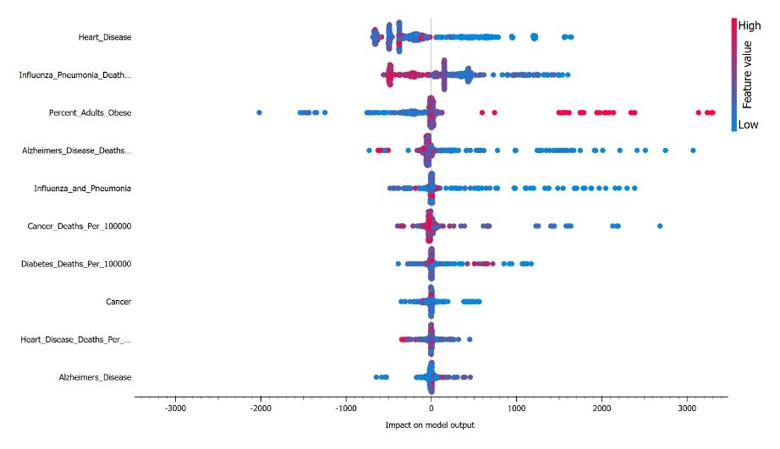
Decision Tree Model Findings Explained on Following Slides
This process was done multiple times for different regions/different targets (healthcare spending/death rate per 100,000)

Slide 29
Results

Slide 30




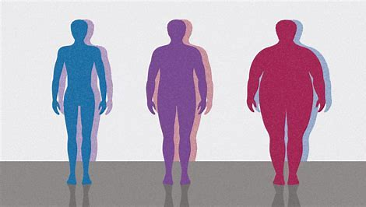
Key Drivers of Healthcare Spending: Heart Disease, smoking rate, obesity (Countrywide)
Heart Disease: Low heart disease rates indicate increased healthcare spending per capita
Smoking rate: Low smoking rate means that healthcare spending is high
Obesity: High obesity rate means there is high healthcare spending per capita, low obesity rate leads to low healthcare spending per capita
Notes:
Scale down the coloring. Mention the dots.

Slide 31

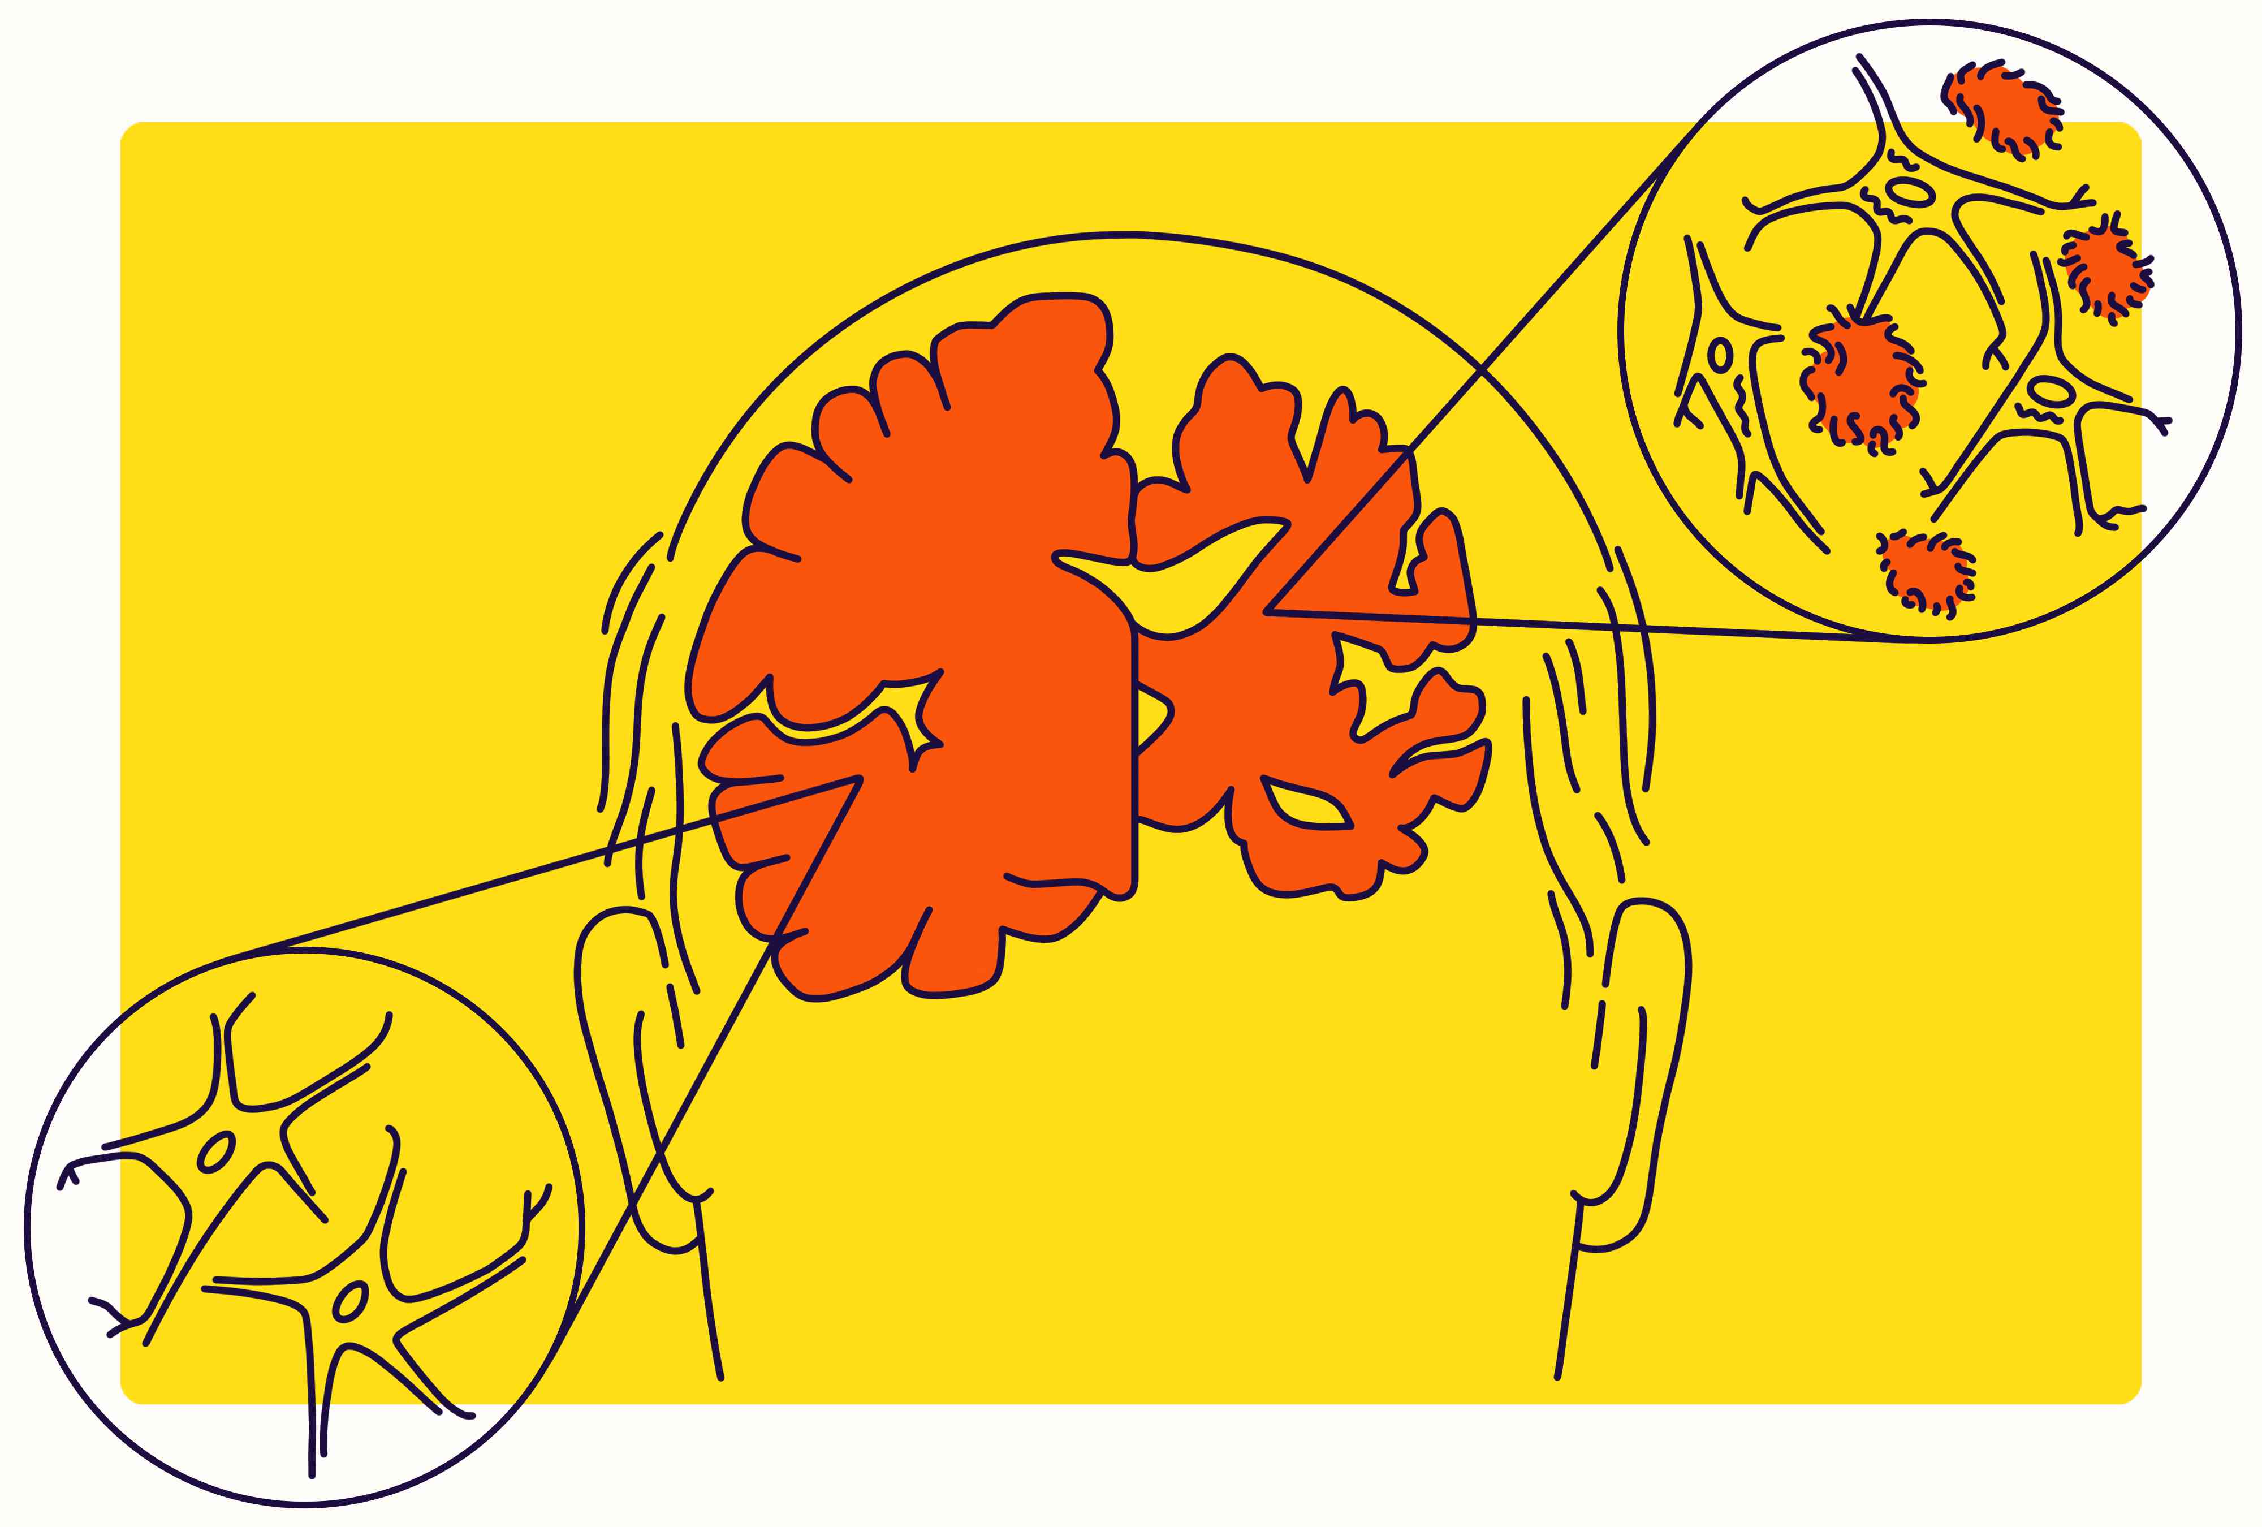

Key Drivers of Healthcare Spending: Obesity, smoking rate, Alzheimer's deaths (Southeast)
Obesity: High obesity rates indicates higher healthcare spending and lower obesity rates indicates lower healthcare spending.
Smoking rate: Low smoking rate suggests that healthcare spending is high, and a higher smoking rate means healthcare spending is lower.
Alzheimer's Disease Deaths: Alzheimer's disease is deadlier in the Southeast, so more money is being spent fighting it

Slide 32


Key Drivers of Death rate per 100,000: Obesity rate, healthcare spending, smoking rate (Countrywide)
Obesity rate: Low rate = lower death rate, high rate = higher death rate
Healthcare spending per capita: When a state's healthcare spending per capita is low, the death rate per 100,000 is low
Smoking rate: High smoking = higher death rate, low smoking = lower death rate

Slide 33


Key Drivers of Death rate per 100,000: Obesity rate, healthcare spending, smoking rate (Southeast)
Healthcare spending per capita: Higher healthcare spending leads to a higher death rate, when healthcare spending per capita is low, the death rate per 100,000 is low
Household Income: Lower household income = higher death rate, higher household income = lower death rate

Slide 34
Recommendations

Slide 35
Target Preventable Chronic Conditions
Heart disease, diabetes, and cancer showed strong correlations with death rates.
States with higher obesity and smoking rates also showed significantly higher mortality.
The Southeast should invest in chronic disease management programs—like free diabetes screenings, heart health awareness campaigns, and subsidized smoking cessation services.

Slide 36
Reducing Smoking Prevalence
Reduce smoking prevalence through a public policy like Minnesota’s Freedom to Breathe Act can lead to lower mortality rates, more specifically cancer and heart disease death rate.​
The Minnesota's Freedom to Breathe Act bans all smoking indoors and in the workplace.

Slide 37
Reducing Obesity Rates
Implement similar programs like the Healthy, Hunger-Free Kids Act help improve school meals, making it easier for kids to eat healthier and lower their risk of obesity.
The Healthy, Hunger-Free Kids Act made school meals healthier by adding more fruits, vegetables, and whole grains. (California, Colorado, Maine, Massachusetts, Michigan, Minnesota, New Mexico, and Vermont)
Notes:
Mention which 9 states have the healthy hunger-free kids act

Slide 38
Next Steps

Slide 39
Data Limitations
Our data doesn’t capture everything that affects healthcare spending and outcomes
Lots of important data is private and we couldn’t access it
Our data goes up 2022, the more recent the better
Infrastructure and policy decisions also play a big role in healthcare

Slide 40
Ways to improve/expand analysis
Collect more data
Consult with public health professionals
Streamline data cleaning for making future analysis more scalable

Slide 41
What Did We Learn
Working off of constructive criticism
01
Doing research and supplementing current findings from the research
02
Overcoming obstacles and communicating effectively
03
Adapting to what our research provided
04

Slide 42
Thank You/Questions?

